Slide 1
Installing Hdef
Matt Herman
Last updated

Slide 2
Requirements
Unix-style operating system: Mac OS, Linux, or WSL
GCC and Gfortran compilers (I cannot guarantee compilation will work with other compilers)
LAPACK is required for some (not all) programs; for LAPACK installation instructions, see the Installing LAPACK tutorial

Slide 3
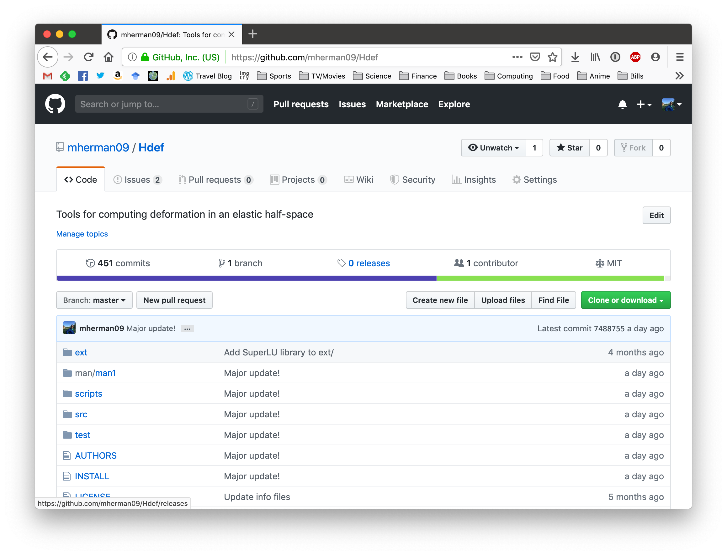
Downloading & Installing
If you use git, clone from:
https://github.com/mherman09/Hdef
Otherwise, download the package by going to this link in a browser

Slide 4
Downloading & Installing
Click here
https://github.com/mherman09/Hdef

Slide 5
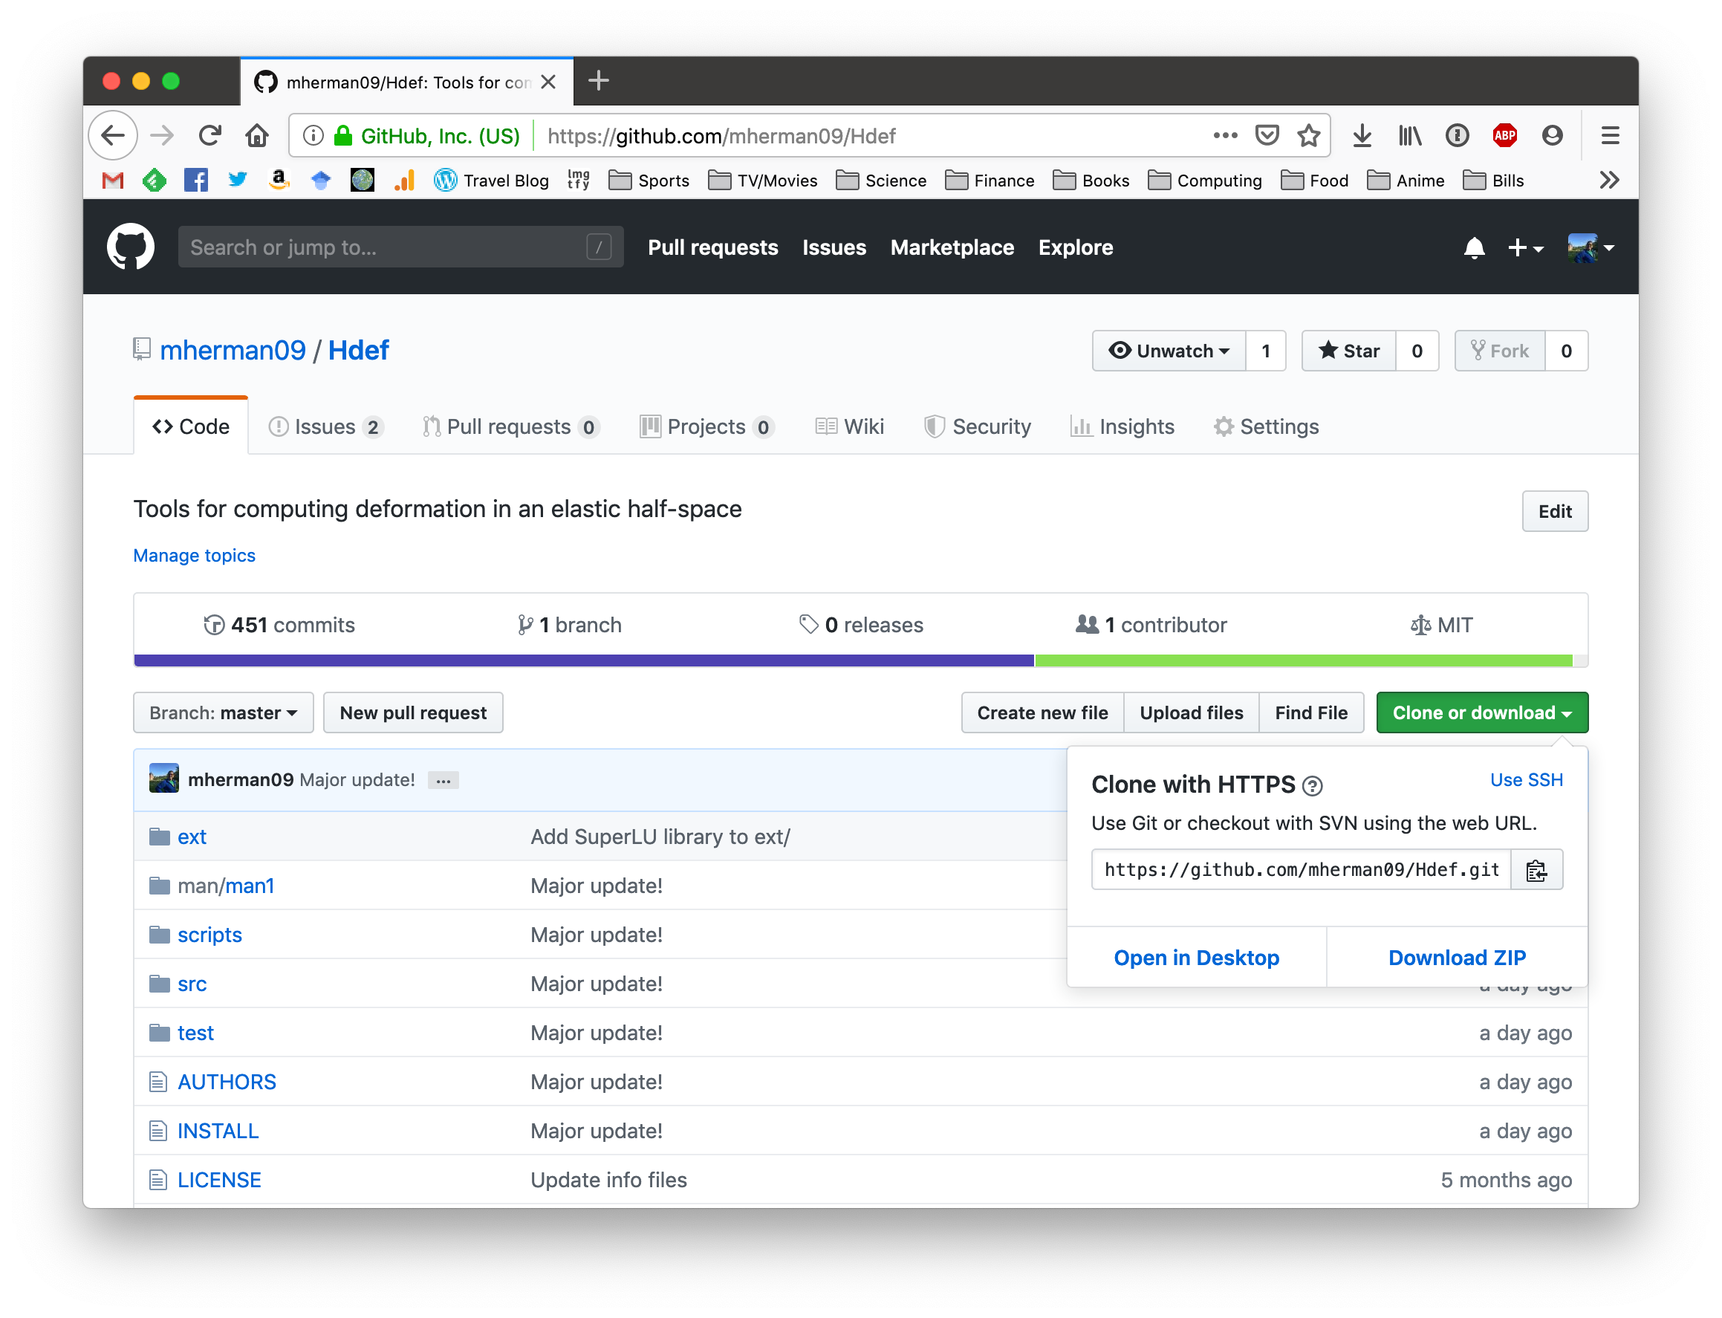
Downloading & Installing
Click here
https://github.com/mherman09/Hdef

Slide 6
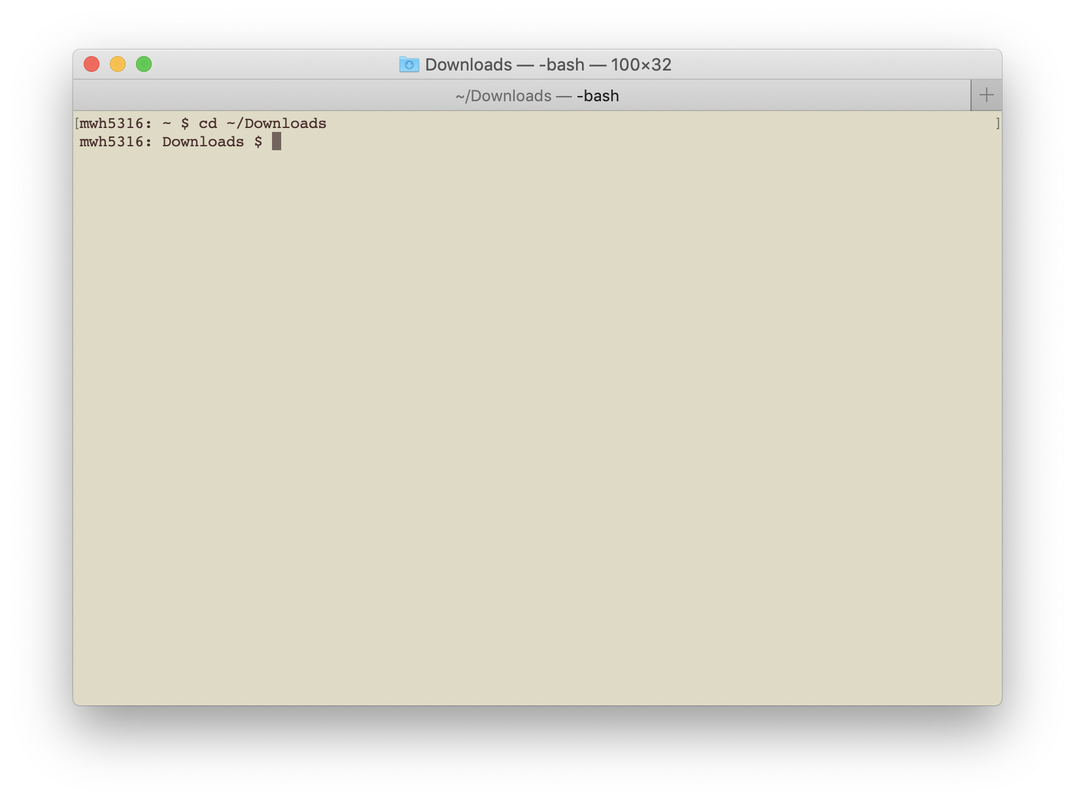
Downloading & Installing
Open a terminal window.
Change directory into ~/Downloads or wherever you saved the zip file.

Slide 7
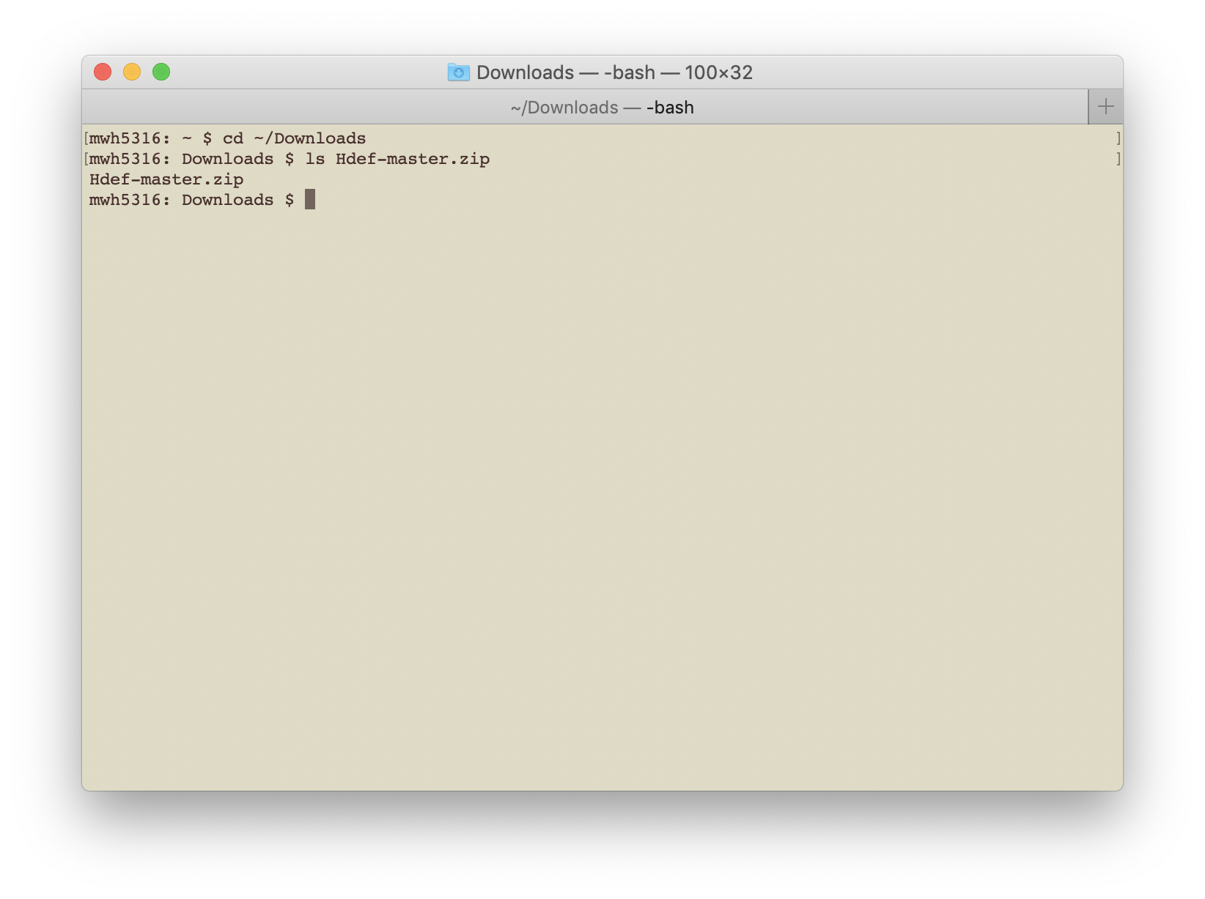
Downloading & Installing
The file name is Hdef-master.zip

Slide 8
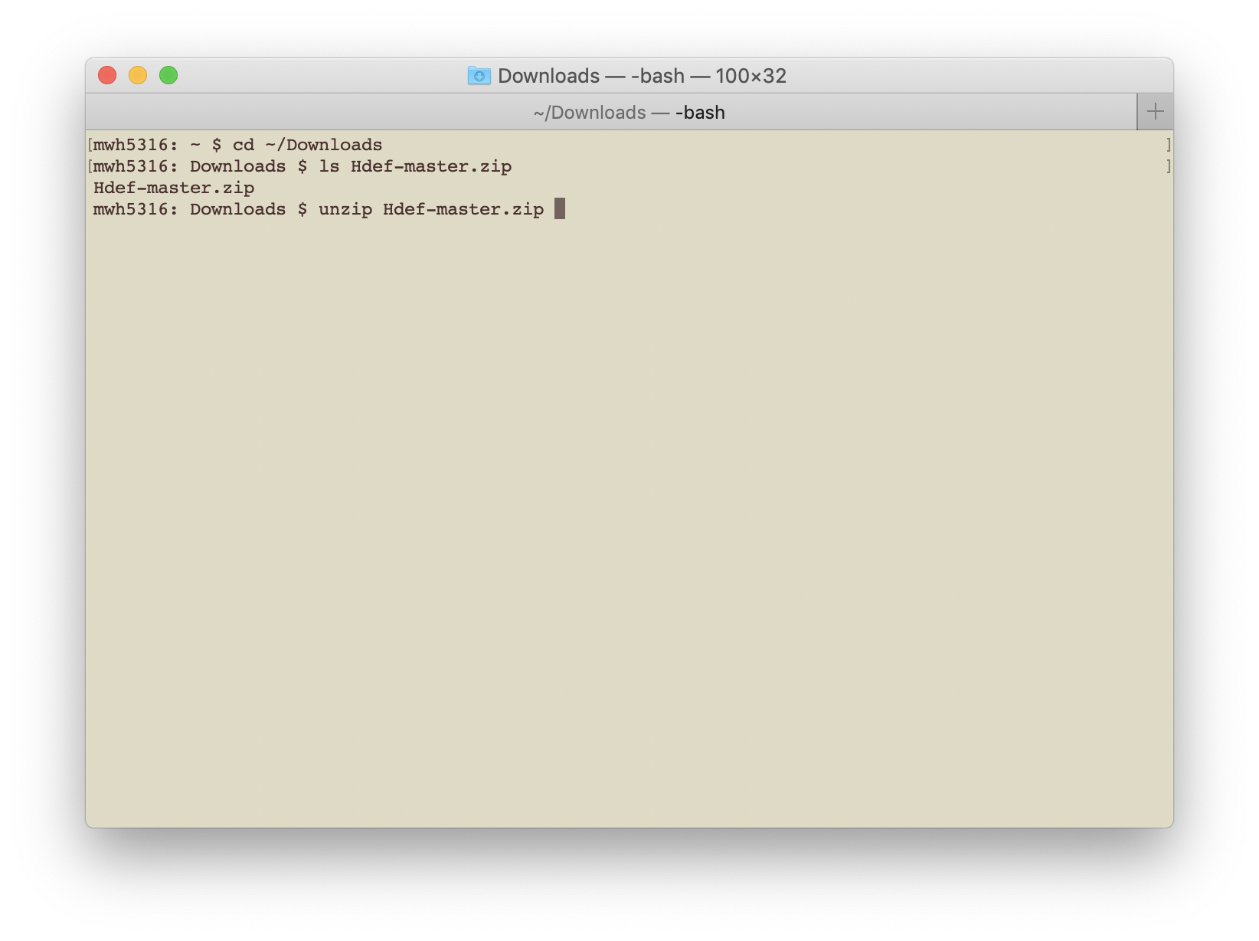
Downloading & Installing
Unzip the file.
The program “unzip” is available on most systems.

Slide 9
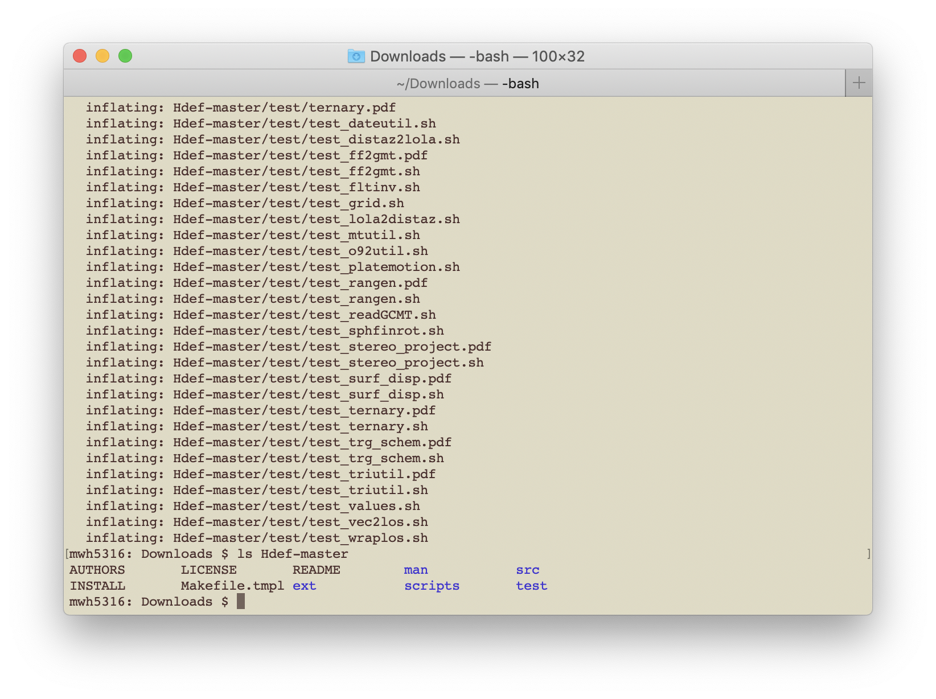
Downloading & Installing
You now have the directory Hdef-master/
Check what is inside. It should contain these files and directories.

Slide 10
Downloading & Installing
src/
Fortran source codes for libraries and executables

Slide 11
Downloading & Installing
scripts/
Bash scripts for automated figures and deformation calculations

Slide 12
Downloading & Installing
test/
Program testing scripts

Slide 13
Downloading & Installing
man/
Man pages

Slide 14
Downloading & Installing
ext/
External packages

Slide 15
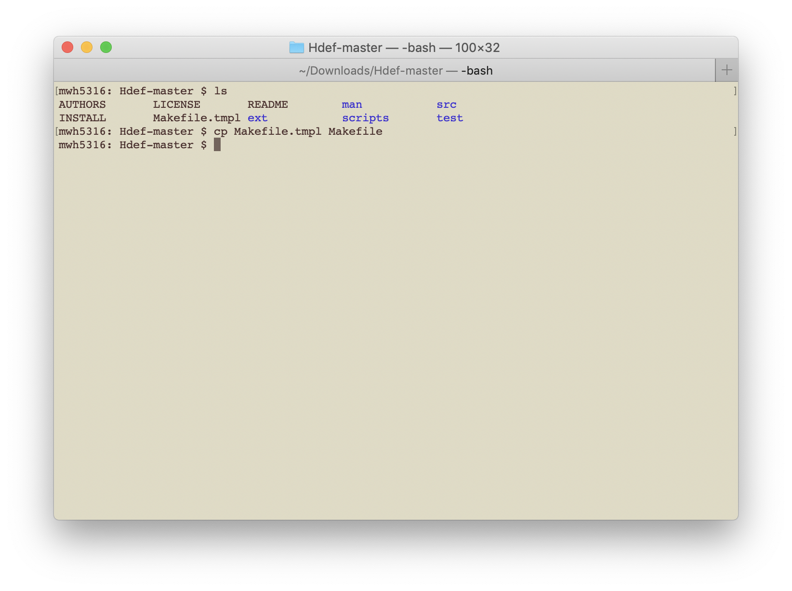
Downloading & Installing
Copy the Makefile template to Makefile

Slide 16
Two Things to Think About Before Installing
(REQUIRED) Decide where you want to install the programs.
(OPTIONAL) If you want to fit curves, do inversions, or manipulate moment tensors, install LAPACK (Linear Algebra PACKage).
See Installing LAPACK
LAPACK is included with Hdef in the ext/ directory

Slide 17
Two Things to Think About Before Installing
(REQUIRED) Decide where you want to install the programs.
(OPTIONAL) If you want to fit curves, do inversions, or manipulate moment tensors, install LAPACK (Linear Algebra PACKage).
See Installing LAPACK
LAPACK is included with Hdef in the ext/ directory
If you want to use the LAPACK-dependent programs, stop this tutorial now and go install LAPACK. The following steps are the same whether you install LAPACK or not.

Slide 18
Two Things to Think About Before Installing
(REQUIRED) Decide where you want to install the programs.
(OPTIONAL) If you want to fit curves, do simple inversions, or manipulate moment tensors, install LAPACK (Linear Algebra PACKage).
See Installing LAPACK
LAPACK is included with Hdef in the ext/ directory
Let’s assume that you want to install the programs in ./bin/
Open the Makefile in a text editor.

Slide 19
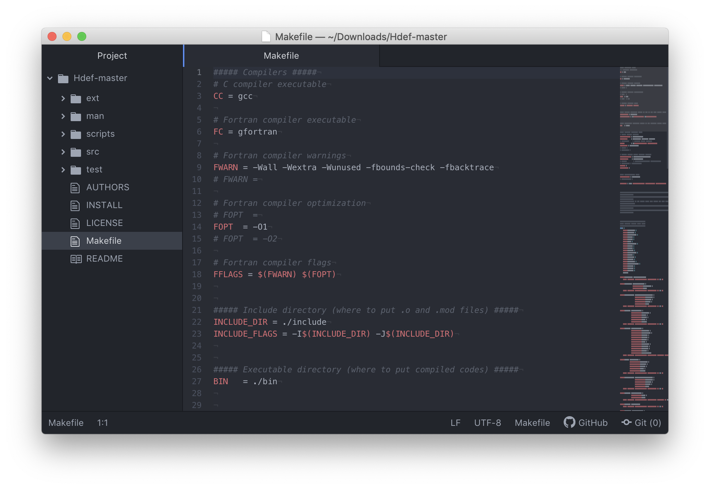
Downloading & Installing

Slide 20
Downloading & Installing
Choose the directory to put executables

Slide 21
Downloading & Installing
If your Fortran and C compilers are somewhere unusual, define the paths here.

Slide 22
Downloading & Installing
Scroll down a few lines....

Slide 23
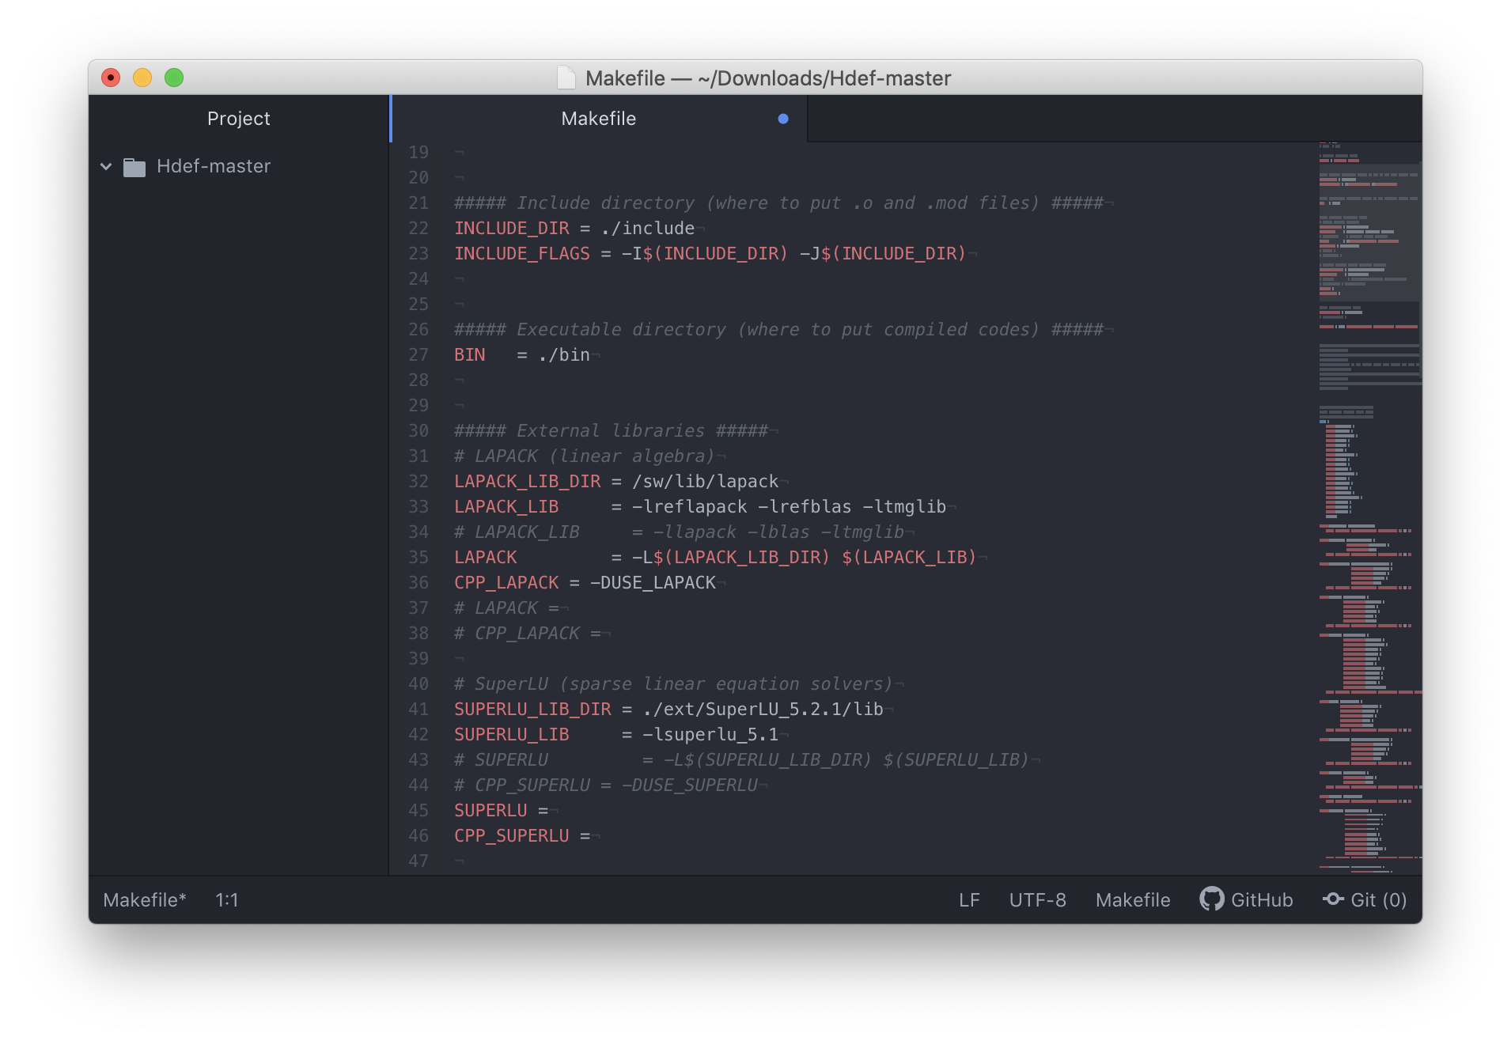
Downloading & Installing
Installing with LAPACK:
Define the location of the LAPACK library
The library names
LAPACK compiler pre-processor

Slide 24
Downloading & Installing
Installing without LAPACK:
Uncomment these blank lines

Slide 25
Downloading & Installing
Finally, type “make”

Slide 26
Downloading & Installing
Last thing: put the directory with the programs into your PATH so the computer can find them any time you use a terminal.
Edit the file .bash_profile (yes, that starts with a ”.”)

Slide 27
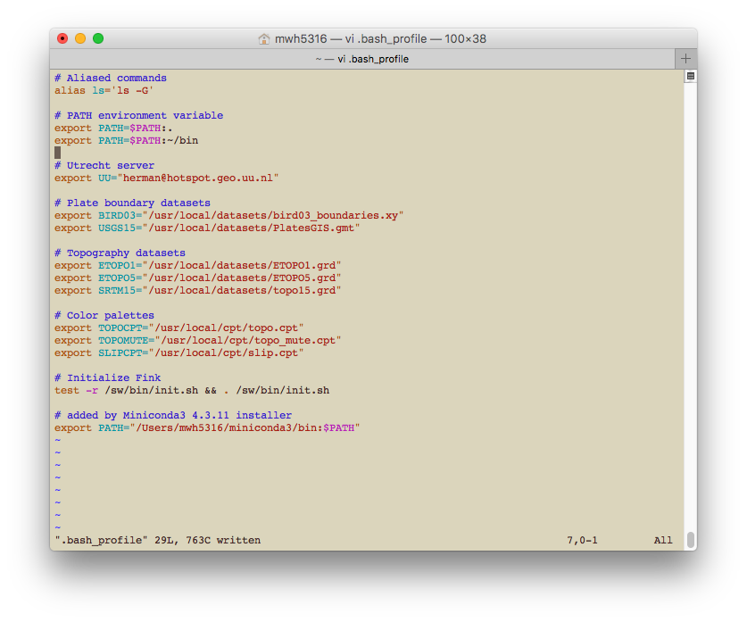
Downloading & Installing
If you installed the Hdef executables in ~/bin, you would add the line:
export PATH=$PATH:~/bin
then close out of your terminal and reopen it.

Slide 28
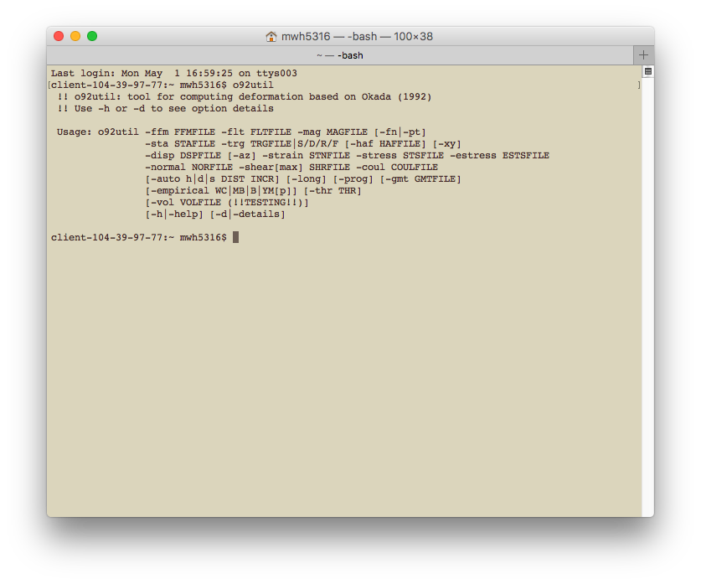
Downloading & Installing
Good to go!
Hdef man pages...

Slide 29
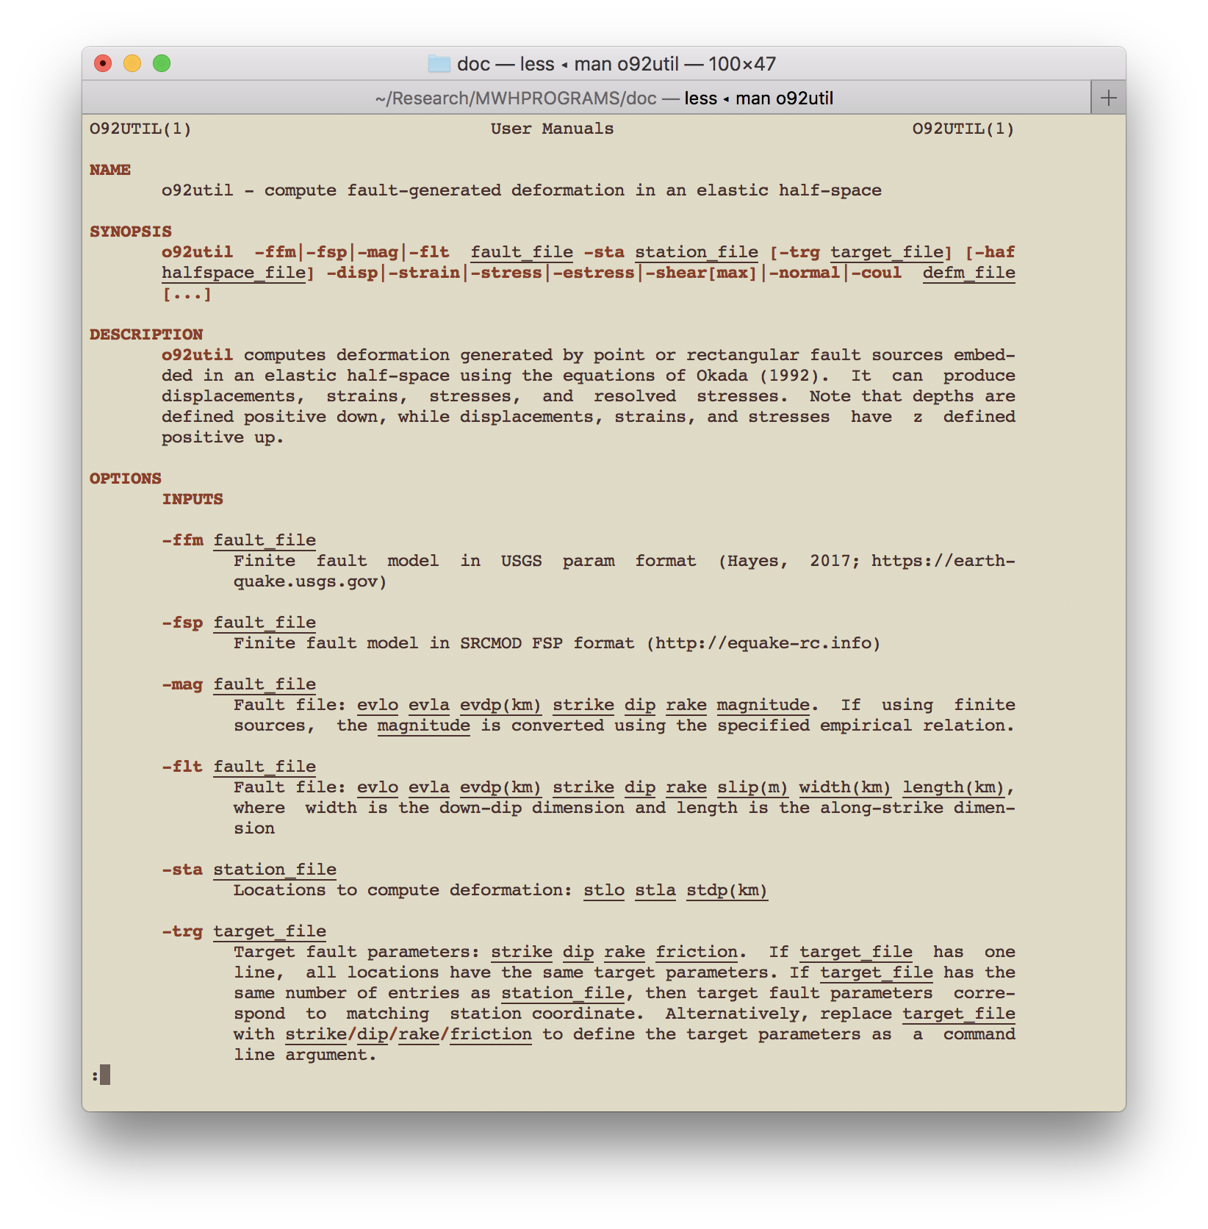
Downloading & Installing
There are man pages for several of the tools. These may be particularly useful for the larger programs with lots of options. These are in the directory:
Hdef-master/man
Add these to the MANPATH variable in your .bash_profile

